Slide 1
Shared Memory Multiprocessors
Symmetric Memory Multiprocessors (SMPs):
commonly 2-4 processors/node
  Symmetric access to all of main memory from any processor.
Currently Dominate the high-end server market:
  Building blocks for larger parallel systems (MPPs, clusters)
Attractive as high throughput servers and for parallel programs:
  Fine-grain resource sharing.
  Uniform access via loads/stores.
  Automatic data movement and coherent replication in caches.
Normal uniprocessor mechanisms used to access data (reads and writes) + synchronization
  Key is extension of memory hierarchy to support multiple processors.
(PCA Chapter 5, 9.1, handout)

Slide 2
Supporting Programming Models
Message passing
Pr
ogramming models
Compilation
Multipr
ogramming
Communication abstraction
or library
User/system boundary
Shar
ed addr
ess space
Operating systems support
Har
dwar
e/softwar
e boundary
Communication har
dwar
e
Physical communication medium
Address translation and protection in hardware (hardware SAS).
Message passing using shared memory buffers:
    Can offer very high performance since no OS involvement necessary.
The focus here is on supporting a consistent or coherent shared address space.

Slide 3
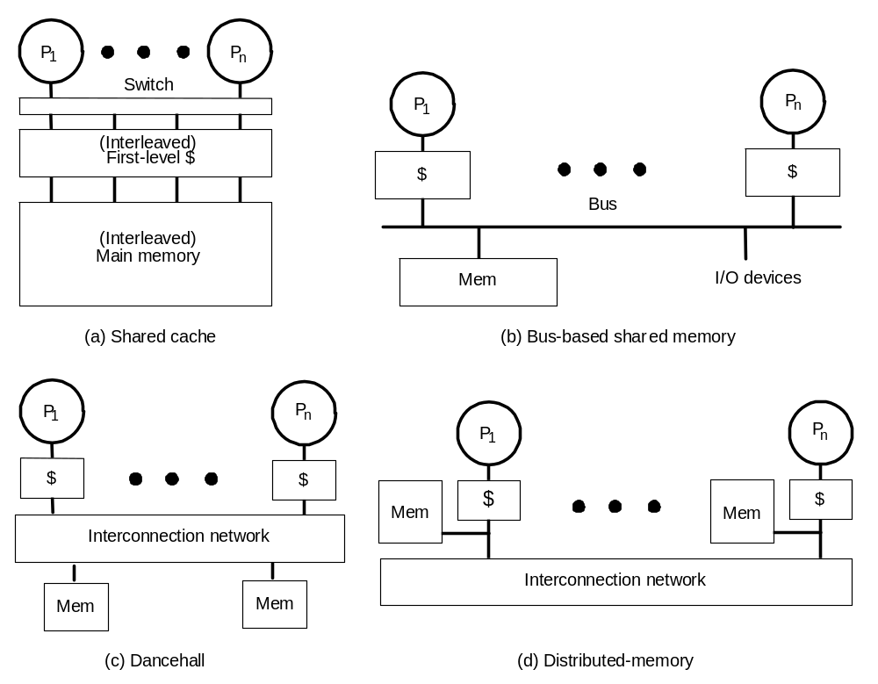
Shared Memory Multiprocessors Variations
Symmetric Memory Multiprocessors
(SMPs)
UMA
UMA
Bus or point-to-point
interconnects
Or SMP nodes
Scalable Distributed
Shared Memory
UMA
Scalable network
p-to-p or MIN
NUMA

Slide 4
Caches And Cache Coherence In Shared Memory Multiprocessors
Caches play a key role in all shared memory Multiprocessor system variations:
  Reduce average data access time.
  Reduce bandwidth demands placed on shared interconnect.
Cache coherence or inconsistency problem.
  Private processor caches create a problem:
    Copies of a variable can be present in multiple caches.
    A write by one processor may not become visible to others:
      Processors accessing stale (old) value in their private caches.
    Also caused by:
      Process migration.
      I/O activity.
  Software and/or hardware actions needed to ensure write visibility to all processors thus maintaining cache coherence.
    i.e. Processors must see the most updated value

Slide 5
Data Sharing/Process Migration
Cache Coherence Problems
See handout
Figure 7.12 in Advanced Computer Architecture: Parallelism, Scalability, Programmability, Kai Hwang.

Slide 6
I/O Operation Cache Inconsistency
See handout
Figure 7.13 in Advanced Computer Architecture: Parallelism, Scalability, Programmability, Kai Hwang.

Slide 7
Shared cache Multiprocessor Systems:
  Low-latency sharing and prefetching across processors.
  Sharing of working sets.
  No coherence problem (and hence no false sharing either).
  But high bandwidth needs and negative interference (e.g. conflicts).
  Hit and miss latency increased due to intervening switch and cache size.
  Used in mid 80s to connect a few of processors on a board (Encore, Sequent).
  Today: Promising for chip multiprocessors (CMPs): 2-4 processors. e.g IBM Power 4, 5 on a chip (shared L2).
Dancehall:
  Not a popular design: All memory is uniformly costly to access over the network for all processors.
Distributed memory:
  Most popular design to build scalable systems (MPPs).

Slide 8
A Coherent Memory System: Intuition
Reading a memory location should return the latest value written (by any process).
Easy to achieve in uniprocessors:
  Except for I/O: Coherence between I/O devices and processors.
  Infrequent so software solutions work:
    Uncacheable memory regions, uncacheable operations, flush pages, pass I/O data through caches.
The same should hold when processes run on different processors:
  E.g. as if the processes were interleaved (or running) on a uniprocessor.
Coherence problem much more critical in multiprocessors:
  Pervasive.
  Performance-critical.
  Must be treated as a basic hardware design issue.

Slide 9
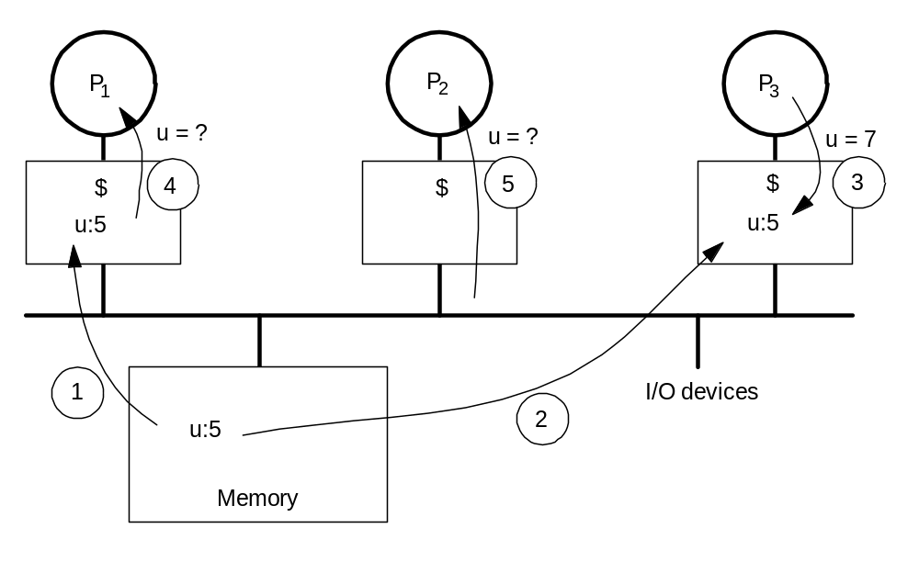
Cache Coherence Problem Example
From
main memory
Write Back
Caches
1 P1 reads u=5 from memory
2 P3 reads u=5 from memory
3 P3 writes u=7 to local P3 cache
4 P1 reads old u=5 from local P1 cache
5 P2 reads old u=5 from memory
  Processors see different values for u after event 3.
  With write back caches, a value updated in cache may not have been written back to memory:
    Processes even accessing main memory may see very stale value.
  Unacceptable: leads to incorrect program execution.

Slide 10
Basic Definitions
Extend definitions in uniprocessors to multiprocessors:
Memory operation: a single read (load), write (store) or read-modify-write access to a memory location.
  Assumed to execute atomically (visible) with respect to (w.r.t) each other.
Issue: A memory operation issues when it leaves processor’s internal environment and is presented to memory system (cache, buffer …).
Perform: operation appears to have taken place, as far as processor can tell from other memory operations it issues.
  A write performs w.r.t. the processor when a subsequent read by the processor returns the value of that write or a later write (no RAW).
  A read perform w.r.t the processor when subsequent writes issued by the processor cannot affect the value returned by the read (no WAR).
In multiprocessors, stay same but replace “the” by “a” processor
  Also, complete: perform with respect to all processors.
  Still need to make sense of order in operations from different processes.

Slide 11
Shared Memory Access Consistency
A load by processor P_{i} is performed with respect to processor P_{k} at a point in time when the issuing of a subsequent store to the same location by P_{k} cannot affect the value returned by the load (no WAR).
A store by P_{i} is considered performed with respect to P_{k} at one time when a subsequent load from the same address by P_{k} returns the value by this store (no RAW).
A load is globally performed if it is performed with respect to all processors and if the store that is the source of the returned value has been performed with respect to all processors.

Slide 12
Formal Definition of Coherence
Results of a program: values returned by its read operations
A memory system is coherent if the results of any execution of a program are such that for each location, it is possible to construct a hypothetical serial order of all operations to the location that is consistent with the results of the execution and in which:
1. operations issued by any particular process occur in the order issued by that process, and
2. the value returned by a read is the value written by the latest write to that location in the serial order
Two necessary conditions:
  Write propagation: value written must become visible to others
  Write serialization: writes to location seen in same order by all
    if one processor sees w1 after w2, another processor should not see w2 before w1
    No need for analogous read serialization since reads not visible to others.

Slide 13
Shared Memory Access Consistency Models
Shared Memory Access Specification Issues:
  Program/compiler expected shared memory behavior.
  Specification coverage of all contingencies.
  Adherence of processors and memory system to the expected behavior.
Memory Consistency Models: Specify the order by which shared memory access events of one process should be observed by other processes in the system.
  Strict Consistency: A read always returns with the most recent write to the same location
  Sequential Consistency (SC) Model: The result of any execution appears the same as the result of the interleaving of individual programs strictly in sequential program order.
  Weak or Relaxed Consistency Models.
Program Order: The order in which memory accesses appear in the execution of a single process without program reordering.
Event Ordering: Used to declare whether a memory event is legal when several processes access a common set of memory locations.

Slide 14
Access Ordering of Memory Events
See handout
Figure 5.19 in Advanced Computer Architecture: Parallelism, Scalability, Programmability, Kai Hwang.

Slide 15
Memory Consistency Models
See handout
Figures 5.20, 5.21 in Advanced Computer Architecture: Parallelism, Scalability, Programmability, Kai Hwang.

Slide 16
Complexities of MIMD Shared Memory Access
Relative order (interleaving) of instructions in different streams in not fixed.
  With no synchronization among instructions streams, a large number of instruction interleavings is possible.
If instructions are reordered in a stream then an even larger of number of instruction interleavings is possible.
If memory accesses are not atomic with multiple copies of the same data coexisting (cache-based systems) then different processors observe different interleavings during the same execution. The total number of possible execution orders becomes even larger.
(Not visible to memory, all processors)

Slide 17
Sequential Consistency (SC) Model
Lamport’s Definition of SC:
  [Hardware is sequentially consistent if] the result of any execution is the same as if the operations of all the processors were executed in some sequential order, and the operations of each individual processor appear in this sequence in the order.
Sufficient conditions to achieve SC in shared-memory access:
  Every process issues memory operations in program order
  After a write operation is issued, the issuing process waits for the write to complete before issuing its next operation.
  After a read operation is issued, the issuing process waits for the read to complete, and for the write whose value is being returned by the read to complete, before issuing its next operation (provides write atomicity).
According to these Sufficient, but not necessary, conditions:
  Clearly, compilers should not reorder for SC, but they do!
    Loop transformations, register allocation.
  Even if issued in order, hardware may violate for better performance
    Write buffers, out of order execution.
  Reason: uniprocessors care only about dependences to same location
    Makes the sufficient conditions very restrictive for performance.

Slide 18
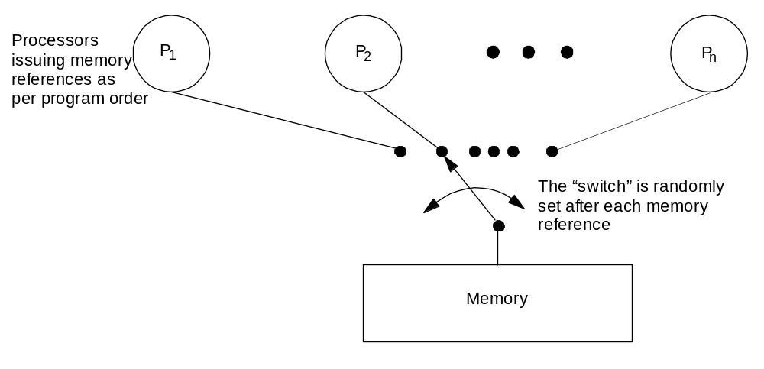
Sequential Consistency (SC) Model
As if there were no caches, and a only single memory exists.
Total order achieved by interleaving accesses from different processes.
Maintains program order, and memory operations, from all processes,
appear to [issue, execute, complete] atomically w.r.t. others
Programmer’s intuition is maintained.

Slide 19
SC Example
P
1
P
2
/*Assume initial values of A and B are
0*/
(1a) A = 1;
(2a) print B;
(1b) B = 2;
(2b) print A;
Possible outcomes for (A,B): (0,0), (1,0), (1,2); impossible under SC: (0,2)
We know 1a->1b and 2a->2b by program order
A = 0 implies 2b->1a, which implies 2a->1b
B = 2 implies 1b->2a, which leads to a contradiction
BUT, actual execution 1b->1a->2b->2a is SC (A,B)=(1,2) despite not program order
    Appears just like 1a->1b->2a->2b as visible from results.
Actual execution 1b->2a->2b-> is not SC (A,B)= (0,2)

Slide 20
Implementing SC
Two types of requirements:
  Program order:
    Memory operations issued by a process must appear to become visible (to others and itself) in program order.
  Atomicity:
    In the overall total order, one memory operation should appear to complete with respect to all processes before the next one is issued.
    Needed to guarantee that total order is consistent across processes.
    Making writes atomic is involved.

Slide 21
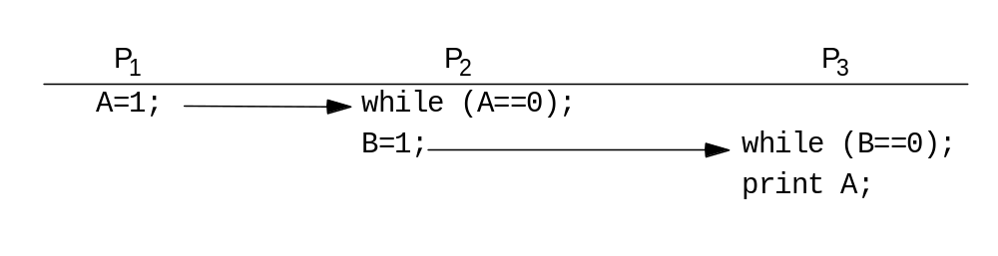
Write Atomicity
Write Atomicity: Position in total order at which a write appears to perform should be the same for all processes:
  Nothing a process does after it has seen the new value produced by a write W should be visible to other processes until they too have seen W.
  In effect, extends write serialization to writes from multiple processes.
  Transitivity implies A should print as 1 under SC
  Problem if P₂ leaves loop, writes B, and P₃ sees new B but old
  A (from its cache).

Slide 22
Further Interpretation of SC
Each process’s program order imposes partial order on set of all operations.
Interleaving of these partial orders defines a total order on all operations.
Many total orders may be SC (SC does not define particular interleaving).
SC Execution: An execution of a program is SC if the results it produces are the same as those produced by some possible total order (interleaving)
SC System: A system is SC if any possible execution on that system is an SC execution.

Slide 23
Weak (Release) Consistency (WC)
The DBS Model of WC: In a multiprocessor shared-memory system:
  Accesses to global synchronizing variables are strongly ordered.
  No access to a synchronizing variable is issues by a processor before all previous global data accesses have been globally performed.
  No access to global data is issued by a processor before a previous access to a synchronizing variable has been globally performed.
Dependence conditions weaker than in SC because they
are limited to synchronization variables.
Buffering is allowed in write buffers except for hardware-
recognized synchronization variables.

Slide 24
TSO Weak Consistency Model
Sun’s SPARK architecture WC model.
Memory access order between processors determined by a hardware memory access “switch”.
Stores and swaps issued by a processor are placed in a dedicated store FIFO buffer for the processor.
  Order of memory operations is the same as processor issue order.
A load by a processor first checks its store buffer if it contains a store to the same location.
  If it does then the load returns the value of the most recent such store.
  Otherwise the load goes directly to memory.
  A processor is logically blocked from issuing further operations until the load returns a value.

Slide 25
Cache Coherence Approaches
Snoopy Protocols: Used in bus-based systems where all processors observe memory transactions and take proper action to invalidate or update local cache content if needed.
Directory Schemes: Used in scalable cache-coherent multiprocessor systems where cache directories are used to store where copies of cache blocks reside.
Shared Caches:
  No private caches.
  This limits system scalability.
Non-cacheable Data:
  Not to cache shared writable data:
    Locks, process queues.
    Data structures protected by critical sections.
  Only instructions or private data is cacheable.
  Data is tagged by the compiler.
Cache Flushing:
  Flush cache whenever a synchronization primitive is executed.
  Slow unless special hardware is used.

Slide 26
Cache Coherence Using A Bus
Built on top of two fundamentals of uniprocessor systems:
  Bus transactions.
  State transition diagram of cache blocks.
Uniprocessor bus transaction:
  Three phases: arbitration, command/address, data transfer.
  All devices observe addresses, one is responsible
Uniprocessor cache states:
  Effectively, every block is a finite state machine.
  Write-through, write no-allocate has two states:
  valid, invalid.
  Write-back caches have one more state: Modified (“dirty”).
Multiprocessors extend both these two fundamentals somewhat to implement cache coherence using a bus.

Slide 27
Snoopy Bus Cache Coherence Protocols
Basic Idea:
Transactions on bus are visible to all processors.
Processors or bus-watching mechanisms can snoop (monitor) the bus and take action on relevant events (e.g. change state) to ensure data consistency among private caches and shared memory.
Basic Protocols:
Write-invalidate:
Invalidate all remote copies of when a local cache block is updated.
Write-update:
When a local cache block is updated, the new data block is broadcast to all caches containing a copy of the block.

Slide 28
Write-invalidate & Write-update Coherence Protocols for Write-through Caches
See handout
Figure 7.14 in Advanced Computer Architecture: Parallelism, Scalability, Programmability, Kai Hwang.

Slide 29
Implementing A Snoopy Protocol
Cache controller now receives inputs from both sides:
  Requests from processor, bus requests/responses from bus snooping mechanism .
In either case, takes zero or more actions:
  Updates state, responds with data, generates new bus transactions.
Protocol is a distributed algorithm: Cooperating state machines.
  Set of states, state transition diagram, actions.
Granularity of coherence is typically a cache block
  Like that of allocation in cache and transfer to/from cache.
  False sharing of a cache block may generate unnecessary coherence protocol actions over the bus.

Slide 30
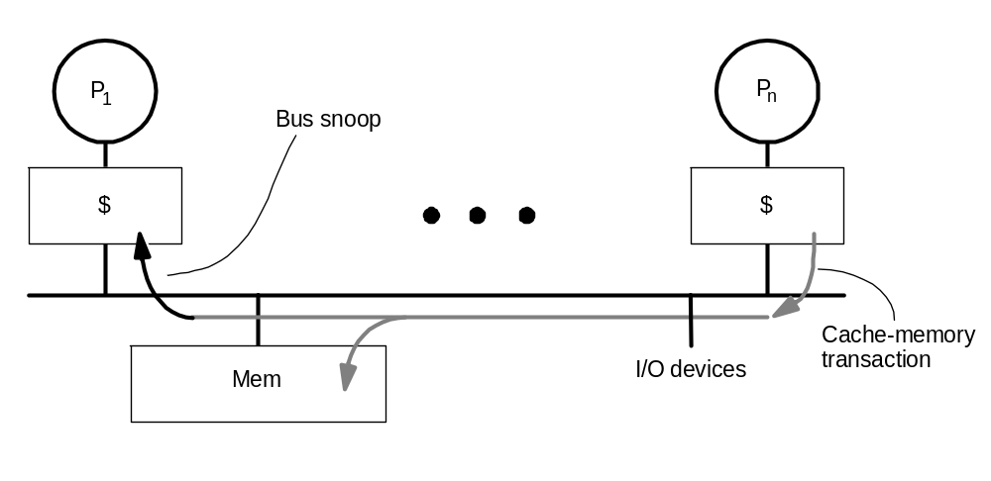
Coherence with Write-through Caches
Possible Action: Invalidate or update cache block in P1 if shared
(Write)
Key extensions to uniprocessor: snooping, invalidating/updating caches:
    No new states or bus transactions in this case.
    Invalidation- versus update-based protocols.
Write propagation: even in invalidation case, later reads will see new value:
    Invalidation causes miss on later access, and memory update via write-through.

Slide 31
Write-invalidate Snoopy Bus Protocol:
For Write-Through Caches
The state of a cache block copy of processor i can take one of two states (j represents a remote processor):
  Valid State:
    All processors can read (R(i),R(j)) safely.
    Local processor i can also write (W(i))
    In this state after a successful read ((R(i)) or write (W(i))
  Invalid State: not in cache or,
    Block being invalidated.
    Block being replaced (Z(i) or (Z(j))
    When a remote processor writes ((W(j)) to its cache copy, all other cache copies become invalidated.
  Bus write cycles are higher than bus read cycles due to request invalidations.

Slide 32
Write-invalidate Snoopy Bus Protocol
For Write-Through Caches
State Transition Diagram
R(j)
Z(j)
Z(i)
W(j)
R(i), W(i)
R(i)
W(i)
R(j)
Z(j)
Invalid
Valid
W(j), Z(i)
W(i) = Write to block by processor i
W(j) = Write to block copy in cache j by processor j ≠ i
R(i) = Read block by processor i.
R(j) = Read block copy in cache j by processor j ≠ i
Z(i) = Replace block in cache .
Z(j) = Replace block copy in cache j ≠ i
i local processor j other processor

Slide 33
Write-invalidate Snoopy Bus Protocol
For Write-Through Caches
A read by
this processor
PrRd/—
PrW
r/BusW
r
Alternate State Transition Diagram
A write by
this processor
V = Valid
I = Invalid
A/B means if A is observed B is generated.
Processor Side Requests:
read (PrRd)
write (PrWr)
Bus Side or snooper/cache controller Actions:
bus read (BusRd)
bus write (BusWr)
V
A read by
this processor
i.e W(j)
PrRd/BusRd
BusW
r/—
Snooper senses
a write by other processor
to same block -> invalidate
A write by other
processor to block
I
PrW
r/BusW
r
Pr
ocessor
-initiated transactions
Bus-snooper
-initiated transactions
  Two states per block in each cache, as in uniprocessor.
    state of a block can be seen as p-vector.
  Hardware state bits associated with only blocks that are in the cache.
    other blocks can be seen as being in invalid (not-present) state in that cache
  Write will invalidate all other caches (no local change of state).
    can have multiple simultaneous readers of block,but write invalidates them.

Slide 34
Problems With Write-Through
High bandwidth requirements:
  Every write from every processor goes to shared bus and memory.
  Consider 200MHz, 1 CPI processor, and 15% of the instructions are 8-byte stores.
  Each processor generates 30M stores or 240MB data per second.
  1GB/s bus can support only about 4 processors without saturating.
  Write-through especially is unpopular for SMPs.
Write-back caches absorb most writes as cache hits:
  Write hits don’t go on bus.
  But now how do we ensure write propagation and serialization?
  Requires more sophisticated protocols: Large design space.

Slide 35
Write-invalidate Snoopy Bus Protocol: For Write-Back Caches
Corresponds to ownership protocol.
The valid state in write-through protocol is divided into two states :
  RW (read-write): (this processor i owns block)
    The only cache copy existing in the system; owned by the local processor.
    Read (R(i)) and (W(i)) can be safely performed in this state.
  RO (read-only):
    Multiple cache block copies exist in the system; owned by memory.
    Reads ((R(i)), ((R(j)) can safely be performed in this state.
  INV (invalid):
    Entered when : Not in cache or,
      A remote processor writes ((W(j)) to its cache copy.
      A local processor replaces ((Z(i)) its own copy.
A cache block is uniquely owned after a local write ((W(i))
Before a block is modified, ownership for exclusive access is obtained by a read-only bus transaction broadcast to all caches and memory.
If a modified remote block copy exists, memory is updated, local copy is invalidated and ownership transferred to requesting cache.

Slide 36
Write-invalidate Snoopy Bus Protocol
For Write-Back Caches
RW: Read-Write
RO: Read Only
INV: Invalidated or
not in cache
State Transition Diagram
R(j)
RW
RO
(Processor i
owns block)
W(i)
R(i)
R(j)
Z(j)
R(i)
W(i)
Z(j)
W(j)
Z(i)
R(i)
W(j), Z(i)
W(i)
INV
W(i) = Write to block by processor i
W(j) = Write to block copy in cache j by processor j ≠ i
R(i) = Read block by processor i.
R(j) = Read block copy in cache j by processor j ≠ i
Z(i) = Replace block in cache .
Z(j) = Replace block copy in cache j ≠ i
i local processor
j other processor
R(j), Z(j), W(j), Z(i)

Slide 37
Basic MSI Write-Back Invalidate Protocol
States:
  Invalid (I).
  Shared (S): Shared unmodified copies exist.
  Dirty or Modified (M): One only valid, other copies
  must be invalidated.
Processor Events:
  PrRd (read).
  PrWr (write).
Bus Transactions:
  BusRd: Asks for copy with no intent to modify.
  BusRdX: Asks for copy with intent to modify.
  BusWB: Updates memory.
Actions:
  Update state, perform bus transaction, flush value onto bus (forced write back).

Slide 38
Basic MSI Write-Back Invalidate Protocol
State Transition Diagram
PrRd/—
PrW
r/—
  M = Dirty or Modified, main memory
  is not up-to-date, owned by local
  processor
  S = Shared, main memory is up-to-date
  owned by main memory
  I = Invalid
Processor Side Requests:
read (PrRd)
write (PrWr)
Bus Side or snooper/cache controller Actions:
Bus Read (BusRd)
Bus Read Exclusive (BusRdX)
bus write back (BusWB) Flush
M
BusRd/Flush
Forced
Write Back
PrW
r/BusRdX
S
BusRdX/Flush
BusRdX/—
PrRd/BusRd
PrRd/—
BusRd/—
PrW
r/BusRdX
I
Invalidate
  Replacement changes state of two blocks: Outgoing and incoming.

Slide 39
MESI (4-state) Invalidation Protocol
Problem with MSI protocol:
  Reading and modifying data is 2 bus transactions, even if not sharing:
    e.g. even in sequential program.
    BusRd ( I-> S ) followed by BusRdX ( S -> M ).
Add exclusive state: Write locally without a bus transaction, but not modified:
  Main memory is up to date, so cache is not necessarily the owner.
  States:
    Invalid (I).
    Exclusive or exclusive-clean (E): Only this cache has a copy, but not modified; main memory has same copy.
    Shared (S): Two or more caches may have copies.
    Modified (M): Dirty.
  I -> E on PrRd if no one else has copy.
    Needs “shared” signal on bus: wired-or line asserted in response to BusRd.

Slide 40
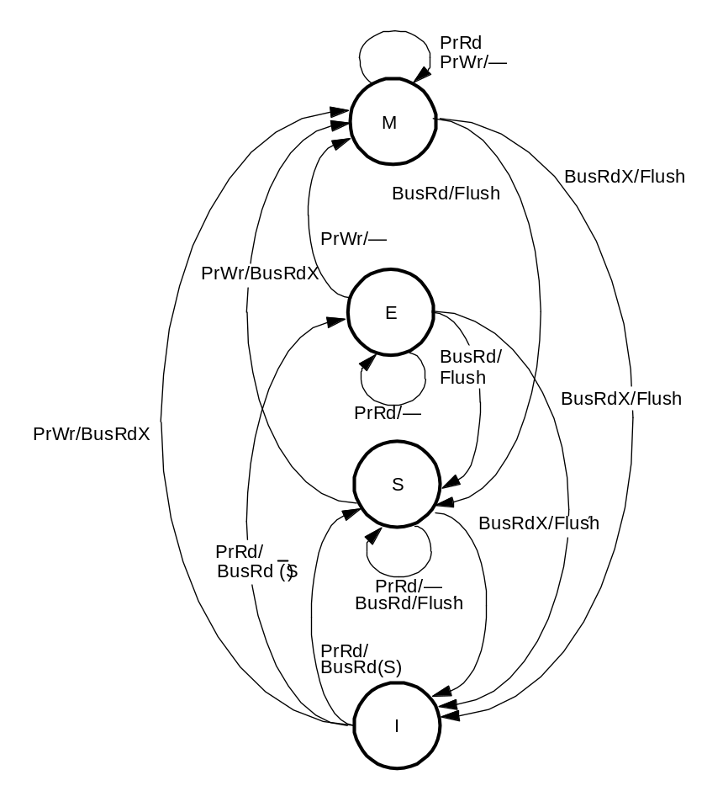
MESI State Transition Diagram
S = shared signal
  BusRd(S) Means shared line asserted on BusRd transaction.
  Flush: If cache-to-cache sharing, only one cache flushes data.

Slide 41
Invalidate Versus Update
Basic question of program behavior:
  Is a block written by one processor read by others before it is rewritten?
Invalidation:
  Yes => Readers will take a miss.
  No => Multiple writes without additional traffic.
    Clears out copies that won’t be used again.
Update:
  Yes => Readers will not miss if they had a copy previously.
    Single bus transaction to update all copies.
  No => Multiple useless updates, even to dead copies.
Need to look at program behavior and hardware complexity.
Invalidation protocols much more popular.
  Some systems provide both, or even hybrid.

Slide 42
Update-based Snoopy Protocols
A write operation updates values in other caches.
  New, update bus transaction.
Advantages:
  Other processors don’t miss on next access: reduced latency
    In invalidation protocols, they would miss and cause more transactions.
  Single bus transaction to update several caches can save bandwidth.
    Also, only the word written is transferred, not whole block
Disadvantages:
  Multiple writes by same processor cause multiple update transactions.
    In invalidation, first write gets exclusive ownership, others local
Detailed tradeoffs more complex.

Slide 43
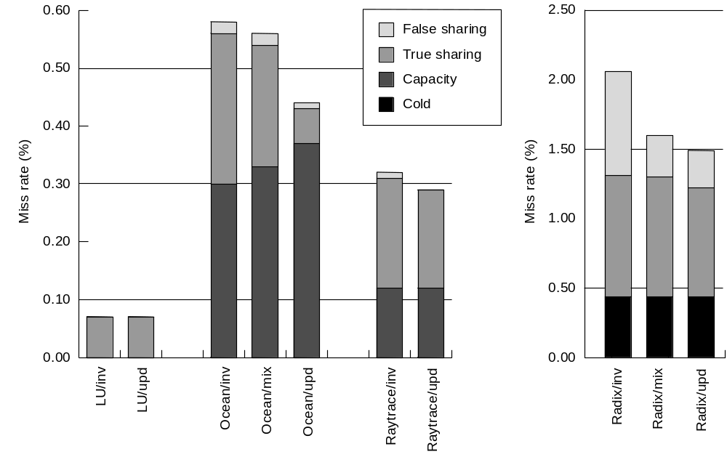
Update Vs. Invalidate: Miss Rates
  Lots of coherence misses: updates help.
  Lots of capacity misses: updates hurt (keep data in cache uselessly).
  Updates seem to help, but this ignores upgrade and update traffic.

Slide 44
Dragon Write-back Update Protocol
4 states:
  Exclusive-clean or exclusive (E): I and memory have this block.
  Shared clean (Sc): I, others, and maybe memory, but I’m not owner.
  Shared modified (Sm): I and others but not memory, and I’m the owner.
    Sm and Sc can coexist in different caches, with only one Sm.
  Modified or dirty (D): I have this block and no one else, stale memory.
No explicit invalid state.
  If in cache, cannot be invalid.
  If not present in cache, can view as being in not-present or invalid state.
New processor events: PrRdMiss, PrWrMiss.
  Introduced to specify actions when block not present in cache.
New bus transaction: BusUpd.
  Broadcasts single word written on bus; updates other relevant caches.

Slide 45
Dragon State Transition Diagram
PrRd/—
PrRd/—
BusUpd/Update
E
BusRd/—
Sc
PrRdMiss/BusRd(S)
PrRdMiss/BusRd(S)
PrW
r/—
PrW
r/BusUpd(S)
S = shared signal
PrW
r/BusUpd(S)
BusUpd/Update
BusRd/Flush
PrW
rMiss/(BusRd(S); BusUpd)
PrW
rMiss/BusRd(S)
Sm
M
PrW
r/BusUpd(S)
PrRd/—
PrRd/—
PrW
r/BusUpd(S)
PrW
r/—
BusRd/Flush

